Slide 1
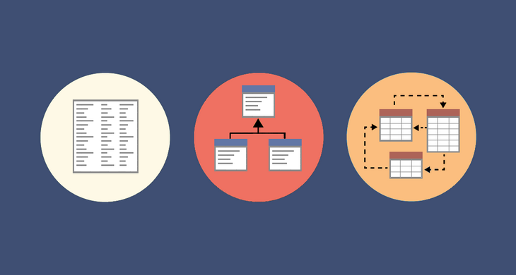
BT2102 ASSIGNMENT 1 GROUP 77
JIRAFE ADITYA VIJAY
LOW YE YANG, CALEB
IVAN CHIN YUE ZE
WONG JIA WEI, NICHOLAS ETHAN

Slide 2
Final Entity and Attributes alsMember, Book
alsMember
Book
memberName
emailAddress
title
publicationYear
faculty
phoneNum
ISBN
publisher
memberID
accNo
BookAuthor

Slide 3
Final Entity and Attributes Fine, Payment
Fine
Payment
fineAmount
fineDate
paymentDate
paymentAmount
memberID
memberID

Slide 4
Final Conceptual Data Model
Book
returnDate
N
N
borrowDate
loans
Reserve
reserveDate
1
M
dueDate
alsMember
1
1
owes
1
clears
1
makes
1
1
Fine
Payment

Slide 5
Final Logical Schema
alsMember (memberID, memberName, faculty, phoneNum, emailAddress)
Book (accNo, title, ISBN, publisher, publicationYear, loanID, loanBorrowDate)
Fine (memberID, fineAmount, fineDate)
Payment (memberID, paymentDate, paymentAmount)
Reserve (memberID, accNo, reserveDate)
BookAuthor (accNo, author)

Slide 6
Final Logical Data Model
alsMember (memberID, memberName, faculty, phoneNum, emailAddress) Primary Key: memberID | Book (accNo, title, ISBN, publisher, publicationYear, loanBorrowDate, loanID) Primary Key: accNo Foreign Key: loanID references alsMember (memberID)
Fine (memberID, fineDate, fineAmount) Primary Key: memberID, fineAmount Foreign Key: memberID references alsMember(memberID) | Payment (memberID, paymentDate, paymentAmount) Primary Key: memberID Foreign Key: memberID references alsMember(memberID)
Reserve (memberID, accNo, reserveDate) Primary Key: memberID, accNo Foreign Key: memberID references alsMember(memberID) Foreign Key: accNo reference Book(accNo) | BookAuthor (accNo, author) Primary Key: accNo, author Foreign Key: accNo references Book(accNo)

